Slide 1


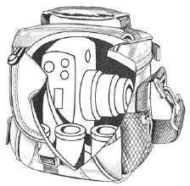
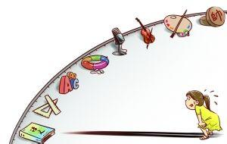
MY WORLD my 2015
01
study
02
Sport
03
Travel
04
201411010329
By：MaJie
Interest

Slide 2

Study
Uh……Okay,although i'am not good at learning,i've got the schoolarship.

Slide 3
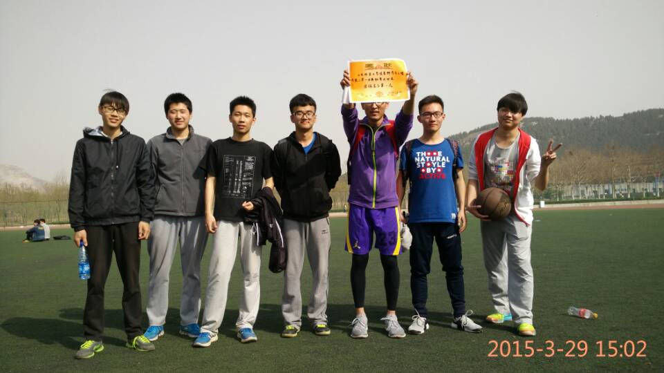
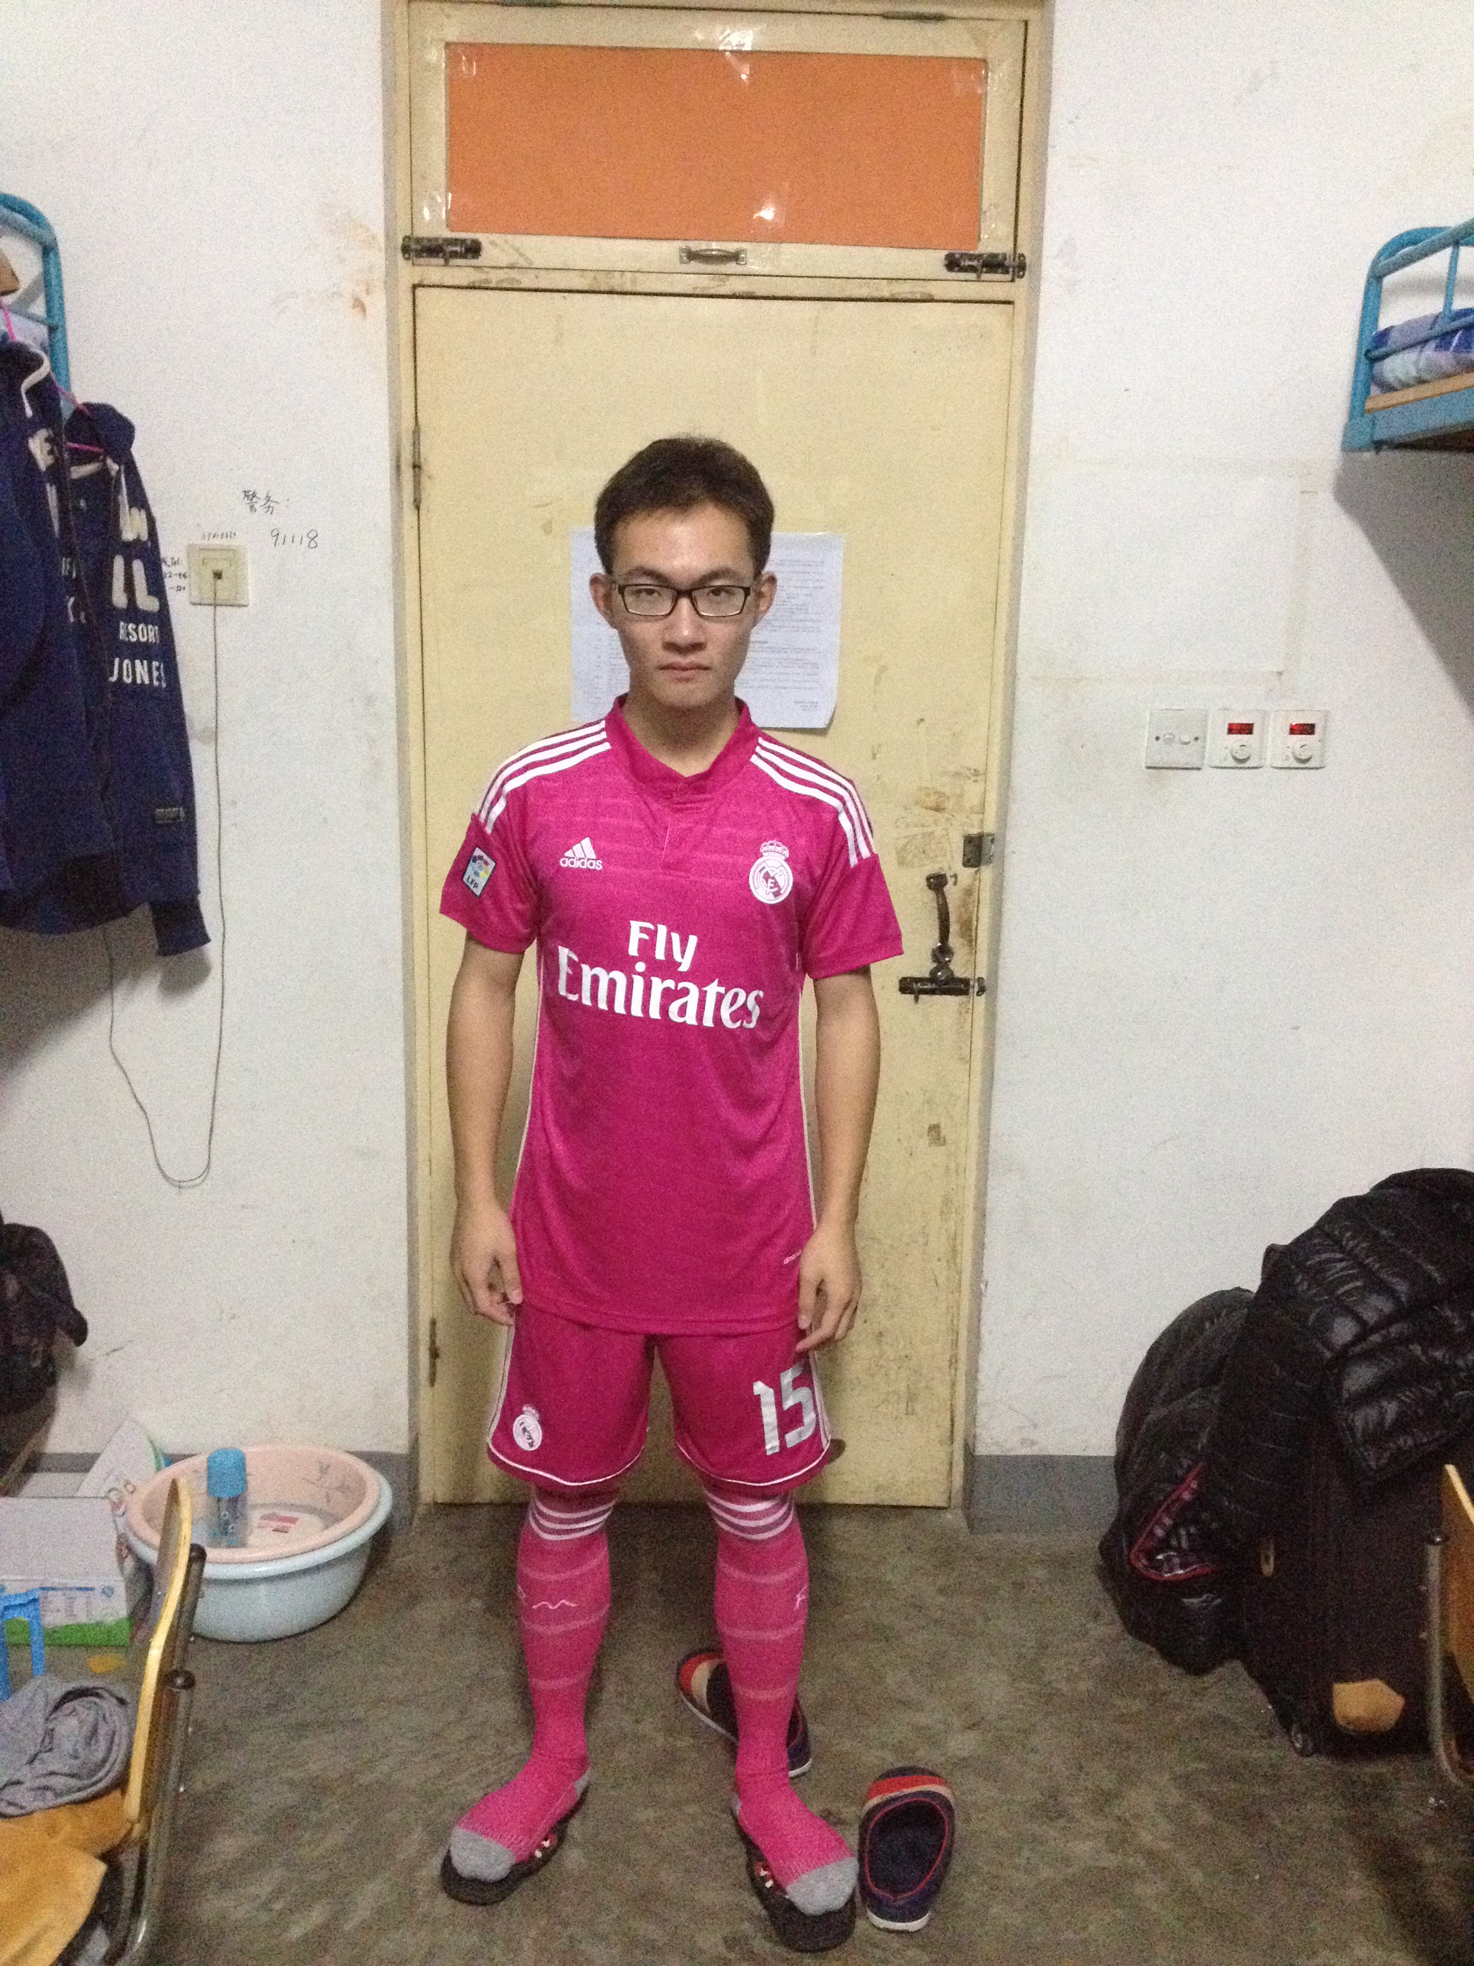
Sport
Yeah,i have to i still have athletic ability and that's my really want.

Slide 4
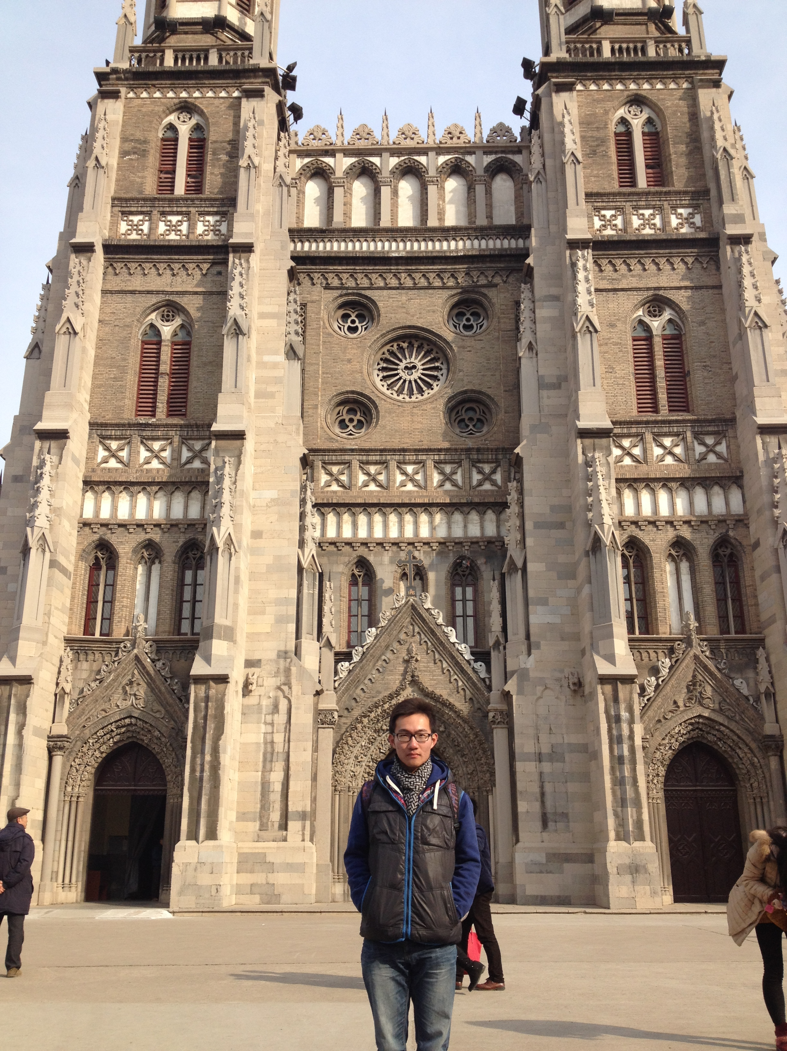
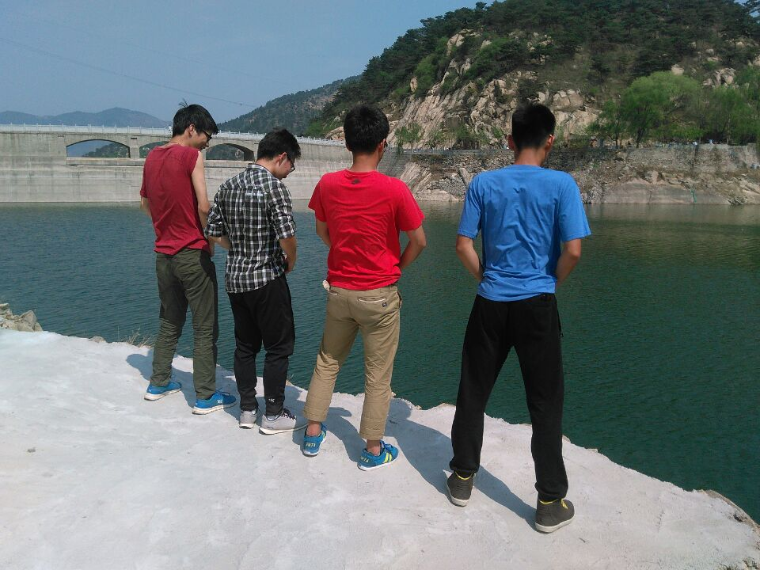
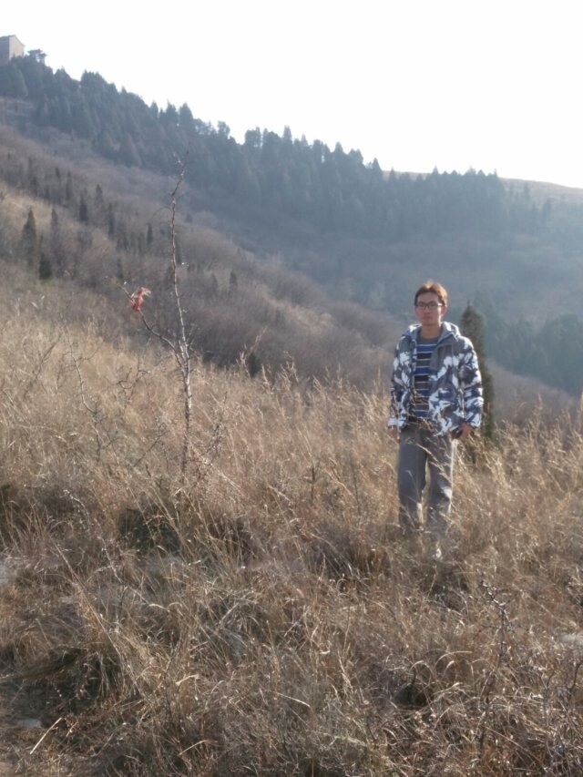
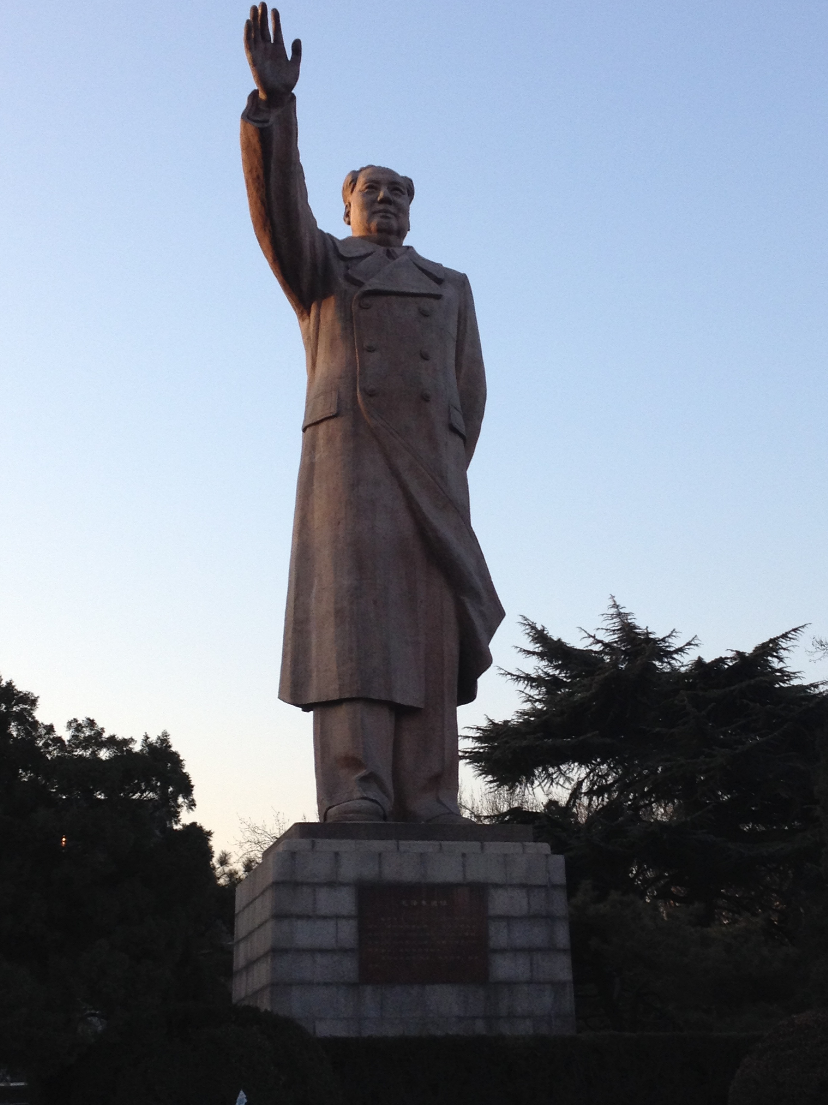
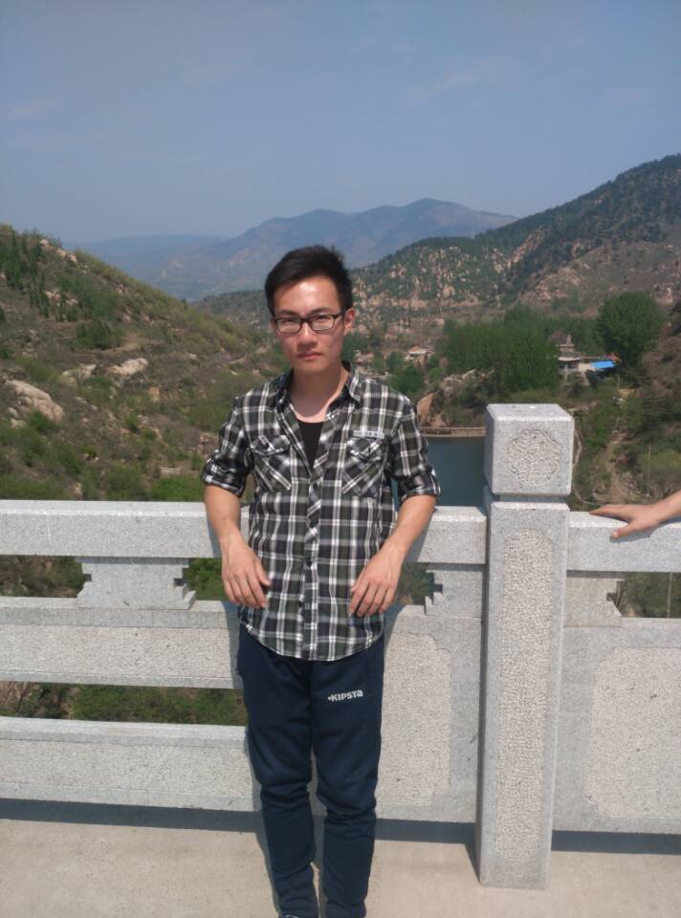
Travel
The whole world is so big, i would like to visit it.

Slide 5

Interest
Yes……you read that right.Stock really is my
interest,although it sounds something strange.
However,I've been doing security analysis for a long time and my dream is to become a fund manager rather than a programmer.

Slide 6
The last word:
“Done is better than perfect”

